Slide 1
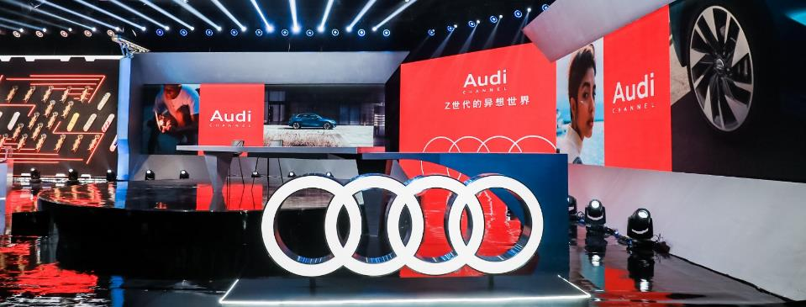
仅确认以下工作内容：
【活动相关】 经办人： 三级经理：
【媒体相关】 经办人： 三级经理：
项目协调人：
二 级 经 理 ：
终期报告：2020奥迪品牌官方直播第一期
Final Report：2020 Audi Channel Official Live Streaming-EP01
ASD-CT-BM 2020/11

Slide 2
传播概览/Comm. Overview
项目概况/Project Overview
传播目标及策略/Comm. Objective & Strategy
传播效果/Communication Effect
执行亮点/Execution Highlights
  媒体反馈/Media Feedback
Ⅳ. 媒体报道总结 /Media report

Slide 3

Audi Channel定位 Positioning of Audi Channel
基于用户运营思维，打造“米其林”级直播，
期期精品、引人入胜
Based on users' operational thinking, to create a Michelin-level live streaming, ensuring each episode with high quality and attractive content.
基于高品质的用户场景、生活方式，打造“种草”内容，
形成奥迪品牌“话题制造机”
Based on high-quality user scenes and lifestyles, the content of "recommending great things" was created through live streaming to form the "topic making machine" of Audi brand.
打造豪华汽车品牌首个
生活方式“种草”类官方直播平台
Build the first official live streaming platform of lifestyle “recommending" for premium car brands

Slide 4






打造奥迪品牌官方直播 三大标签化亮点模块
Create Audi brand official live streaming with three major highlights module
01
奥迪好玩
Audi’s fun
每期一个热点话题、IP
Each episode with a hot topic, IP
02
奥迪好物
Audi’s goods
每期一款跨界联名好物
Each episode with a co-branding good
03
奥迪好惊喜
Audi’s surprise
每期一个惊喜的奥迪车型
Each episode with a surprising Audi model
1位重磅领导
An Internal Leader
1组重磅嘉宾
A group of Guests
1款奥迪好物
A great good of Audi
1款重磅产品
An important model
1个资源入驻
One resource to combine
一汽-大众奥迪副总及以上级别高层
英杰汇成员/流量名人/品牌挚友/奥迪车主/专业人士
产品周边/名人爱物/奥迪精品
上市新车/话题车型/明星车型/传播期产品
品牌赞助/品牌活动
Members of Audi Vorsprung Circle/great celebrities/brand friends/Audi owners/professionals
Audi co-branding good/ celebrity favorites/Audi collection
New models / topic models / star models/products in the communication period
Brand sponsorship/
brand events
FAW-VW Audi VP or above

Slide 5

奥迪品牌官方直播 第一期 Audi Channel Official Live Streaming-EP01
奥迪 x Z世代的异想世界
Audi X Generation Z’s Fantasy World
奥迪的创新精神 x Z世代的美好生活
Audi of Generation Z
Audi's spirit of innovation X the good life of Generation Z
Normal is Boring…
这里是属于Z世代的生活方式实验室，一个与众不同的奥迪官方直播间
This is a Gen Z lifestyle lab, an official Audi live streaming room different from others
这里以奥迪的创新精神驱动，泛娱乐化直播种草Z世代奥迪的 “人、货、场”
打造一个更年轻、更具魅力的 “四环次元”直播空间，成为Z世代心目中的C位“引力”
Here, driven by Audi's spirit of innovation, pan-entertainment livestream about Gen Z's "People, Goods and Fields“
Create a younger and more attractive "four-ring dimensional" live space, and become the "gravitation" in generation Z's mind.

Slide 6



核心要素 Core Elements
Audi Channel
奥迪 x Z世代的人、货、场
Audi x Z Generation’s People, Goods, Field
人：Z世代圈子
People: Generation Z Circle
货：Z世代x奥迪限定好物
Goods: Z-Gen X Audi limited goods
场：奥迪的Z世代“栖息地”
Field: Audi's Gen Z 'Habitat'
动漫、音乐、潮流、科技、运动等Z世代话题设定;顶级流量idol+圈层代表
Generation Z topics such as animation, music, fashion, technology, sports, etc; Top Idol + circle layer representative
跨界重磅联名开发
IP周边好物
Cross - boundary blockbuster
joint development
IP Good things
炫酷、多场景、多元文化交流地
平等互动小嗨的社交化沟通方式（标签模式化）
Cool, multi - scene, multi - cultural exchange
Equal Interaction
- social communication mode

Slide 7
首期直播规划 EP01 Content Planning
奥迪 x Z世代的异想世界
Audi X Generation Z’s Fantasy World
奥迪好玩 Audi’s Fun
未来：二次元幻想
The future: Two dimensional fantasy
奥迪好物 Audi’s Goods
现实：三次元创想
The reality: Third dimensional thinking
奥迪好惊喜 Audi’s Surprise
近未来的现实异想
Visions of the near future
圈层
Circle
奥迪 x 国漫
Audi X Chinese Animation
奥迪 x 极限运动
Audi X Extreme Sport
奥迪 x 移动出行
Audi X Mobile Travel
IP话题
IP Topic
《灵笼》创作幕后
《INCARNATION》
奥迪x王一博联名滑板
Audi X Wang Yibo co-branded skateboard
奥迪 x 王一博联名全新奥迪A3
Audi X Wang Yibo co-branded Audi A3
国漫崛起《灵笼》创作灵感
与奥迪合作，白月魁+奥迪概念车
独家白月魁手稿揭秘
The Creative inspiration of 《INCARNATION》
Bai Yuekui + Audi AI:TRAIL
滑板文化（极限运动鼻祖）
王一博的梦想滑板（设计、功能诉求）
滑板 x 奥迪科技，联名滑板揭秘
The dream skateboard of Wang Yibo
Skateboard x Audi Tech
The design story of the skateboard
“Z世代奥迪”
奥迪未来出行畅想
奥迪 x 王一博联名A3线上预约及秒杀
Audi's vision for the future mobility
The co-branded Audi A3 is accepting online booking,
and only one for snapping up.
互动
内容
Interactive Content
好物
Great Goods
《灵笼》手稿、笔记本、T恤、帽子
Manuscripts, posters, notebooks, T-shirts
王一博联名滑板
Wang Yibo co-branded skateboard
奥迪 x 王一博联名全新奥迪A3
Audi X Wang Yibo co-branded Audi A3

Slide 8
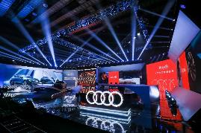
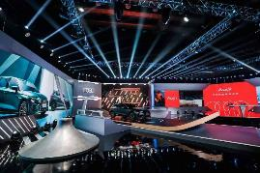
奥迪品牌官方直播第一期 Audi Channel Official Live Streaming-EP01
上线时间：11月16日 20:00-22:00
Launch Date：Nov. 16th , 8 p.m.-10:00 p.m
时长 Length：120 min
上线平台 Platform：抖音 Tik Tok
直播间地点 Studio Location：
大厂影视产业园
Dachang Film and Television Industry Park
参与嘉宾 Guests：
《灵笼》出品人、艺画天开CEO 阮瑞
《INCARNATION》Producer & Mr. Ruan Rui
YHKT ENTERTAINMENT CEO
《灵笼》主创、音乐制作人 杨秉音
Creator/music producer of Mr. Yang Bingyin
《INCARNATION》
奥迪中国设计师 武云舟
Audi China Designer Mr. Wu Yunzhou
中国滑板第一人 车霖
China's pioneering skateboarder Mr.Che Lin
品牌惊喜官 张总
Brand Surprise Officer Mr. Zhang Qiang
频道主理人 Channel Host：
中国内地主持人、潮流品牌NPC主理人 李晨Li Chen,Nic
Famous host and lead author of the fashion brand NPC

Slide 9








Audi Channel 首秀成绩亮眼 Stunning results in EP01
Audi Channel通过直播生态流量优化+内外资源流量管理，实现了品牌曝光度与好感度的强势增长
Audi Channel achieved a strong increase in brand exposure and favorability through live stream ecological flow optimization + internal and external resource flow management
全网瞩目 C位出道
Attention of the whole network
全网累积
曝光量
Network exposure
74mio+
直播累积
观看量
Total views
3.15mio+
抖音
总点赞量
Tik Tok total likes
110 mio+
首期直播
涨粉量
Tik Tok Fan growth 100,000+
预热234家累计播放3400W
参与直播间互动100家
媒体报道2358篇，广告价值3亿元，热点话题排名top3
横向拓展 资源赋能
Internal development and resource sharing
优质内容 持续发酵
Continuous fermentation of
high quality content
#Audi Channel#相关话题阅读量
Topic reading
奥迪京东旗舰店访问量
Audi JD flagship store visits
80,000+
截至直播结束
By the end of the live broadcast
30mio+
王一博联名限量款A3预约量
Wang Yibo joint limited
edition A3 reservations
20,000+
截至11月20日
As of 18:00, November 20
100mio+
Notes:
效率会文件中的立项KPI：抖音直播累积观看量达2000w+；奥迪官方抖音新增粉丝数14w+
京东奥迪官方旗舰店粉丝数目前20w+，建议 访问量、预约量、涨粉量
奥迪官方直播这件事 触达人次
内部全员营销

Slide 10
Audi Channel直播项目舆情监测
舆情情况
截止11月30日，关于“奥迪Channel直播项目“舆情总声量为2,408篇次，正面报道数量2,394篇，占比99.4%；中性报道数量14篇，占比0.6% 。收集剪报广告总价值293,782,159元；其中网络媒体1,152篇，广告价值77,350,000元；新媒体1,249篇，广告价值216,360,123元；广电媒体1篇，广告价值72,036元；微博6篇。
本周主要传播关键词：仪式感、惊喜感、潮流风范、运动感
舆情声量调性分析
传播主要热点话题Top5
序号 | 文章标题 | 触达人次 | 调性
1 | 车动态：新速腾上市；丰田全新轿车；奥迪A3联名版发布 | 193,056 | 正面
2 | 限量23台！全新奥迪A3王一博联名限量款购买攻略来了 | 187,370 | 正面
3 | Audi Channel直播首秀点赞过亿 Z世代营销破圈出道 | 173,946 | 正面
4 | 独家呈现“跨次元、破圈层”的直播新玩法 奥迪官方直播Audi Channel第一期完美收官 | 157,957 | 正面
5 | 这或许是你女朋友最好的礼物 奥迪A3王一博限量版售26.85万！ | 145,397 | 正面

Slide 11
Audi Channel live broadcast project public opinion monitoring
Public opinion
As of November 30, the total volume of public opinion on the "Audi Channel Live Project" was 2,408, with 2,394 positive reports, accounting for 99.4%; and the number of neutral reports, 14, accounting for 0.6%. The total value of advertisements collected from newspaper clippings was 293,782,159 yuan; of which 1,152 were online media, with an advertising value of 77,350,000 yuan; 1,249 were new media, with an advertising value of 216,360,123 yuan; 1 radio and television media, with an advertising value of 72,036 yuan, and 6 on Weibo.Key words to spread this week: sense of ceremony, sense of surprise, fashion style, sense of sport
Tonal analysis of public opinion volume
Top 5 main hot topics to spread
Serial number | Article title | Reached | Tonal
1 | Car dynamics: new Sagitar launched; Toyota new sedan; Audi A3 co-branded version released | 193,056 | positive
2 | Limited to 23 units! The new Audi A3 Wang Yibo joint limited edition purchase guide is here | 187,370 | positive
3 | Audi Channel's live broadcast debut over 100 million likes, generation Z marketing breaks the circle debut | 173,946 | positive
4 | Exclusively presenting the new gameplay of "cross-dimension, breaking the circle" of the live broadcast The first phase of Audi's official live broadcast of Audi Channel ended perfectly | 157,957 | positive
5 | This may be the best gift for your girlfriend. Audi A3 Wang Yibo Limited Edition sold for 268,500! | 145,397 | positive
Total public opinion
2,408

Slide 12
传播概览/Comm. Overview
II. 执行亮点
Execution Highlights
  媒体反馈/Media Feedback
Ⅳ. 媒体报道总结 /Media report

Slide 13


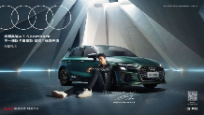


Audi Channel直播项目亮点
树立了豪华汽车品牌
官方直播的
新标杆
创造了抖音生态
单场直播点赞量的
最高纪录
实现全员营销
全网联动，助力传播声量
最大化
打造豪华汽车品牌首个生活方式“种草”类官方直播平台，呈现直播界的米其林盛宴
“好玩 好物 好惊喜”三大模块内容引爆，实现真正的跨界破圈，成功吸引汽车圈、国漫圈、滑板圈及粉丝圈的关注，反响热烈
成为抖音生态现象级的品牌官方直播案例
实现破纪录式的直播点赞量1.1亿+
助力奥迪官方抖音账号粉丝突破100W
内部首次实现了奥迪市场部的资源整合，调动部门最多且合作最为紧密
纵向实现总部-区域-经销商三级联动
横向打通全网资源，如王一博粉丝、灵笼粉丝、车圈KOL等
充分利用王一博的流量IP，撬动声量

Slide 14




Audi Channel直播项目亮点
Established a luxury car brandOfficial live
New benchmark
Created the vibrato ecologyLikes for a single live broadcast
Highest record
Realize full-staff marketingNetwork-wide linkage to help spread the volumemaximize
Create the first official live broadcast platform of the luxury car brand's lifestyle "grass planting" category, presenting the Michelin feast in the live broadcast industry
The content of the three modules of "Fun, Good Things, Good Surprises" detonated, realizing a real cross-border break, and successfully attracted the attention of the car circle, the national comic circle, the skateboard circle and the fan circle, and the response was enthusiastic
For the first time, the internal resources integration of the Audi marketing department was realized, with the most mobilized departments and the closest cooperation
Vertically realize the three-level linkage of headquarters-region-dealers
Open up resources across the entire network horizontally, such as Wang Yibo fans, Lingcage fans, KOLs, etc.
Make full use of Wang Yibo’s traffic IP to move the volume of sound
Become a brand official live broadcast case of Douyin ecological phenomenon
Achieved a record-breaking live broadcast of 110 million+ likes
Help Audi's official Douyin account fans break through 100W

Slide 15


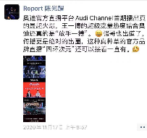
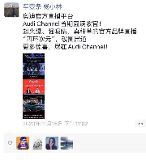
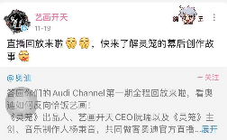
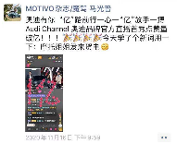


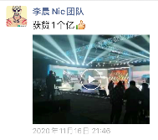
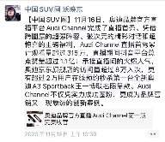
各圈层人群互动精彩瞬间
Wonderful moments of interaction with people from all circles
媒体高度评价
Highly rated by the media
直播间互动热烈
Warm interaction in the live broadcast room
参与嘉宾积极参与
Participating guests actively participate
车圈媒体对Audi Channel高度评价，并积极主动的转发直播相关物料The rim media spoke highly of Audi Channel and actively forwarded live broadcast related materials
媒体大佬及粉丝群体在直播间内互动热烈，高潮迭起Media tycoons and fan groups interacted enthusiastically in the live broadcast room, with climaxes
直播嘉宾武云舟、灵笼团队、李晨nic等，通过个人/自媒体渠道对直播效果表示赞叹Live broadcast guests Wu Yunzhou, Lingcage team, Li Chennic, etc. expressed their admiration for the live broadcast effect through personal/we-media channels
吴佩
南哥
终极小腾
高转青年

Slide 16

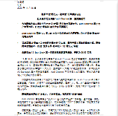
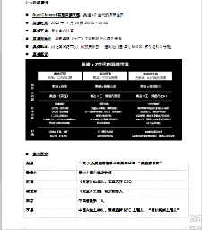
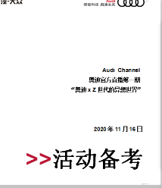
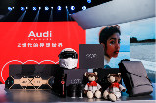
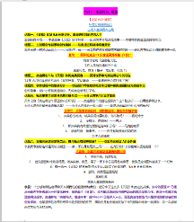
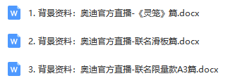
丰富且全面的背景资料 Comprehensive Background Info.
为媒体提供详尽的文字资料、图片素材、视频素材等，收到媒体的一致好评。
Provide a very diverse range of materials, including detailed text materials, picture materials, video materials, etc., received the media acclaim
新闻稿
Press release
活动备考
Activity handbook
背景资料（3篇）
Background Information

Slide 17

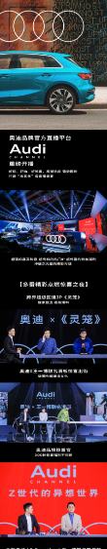
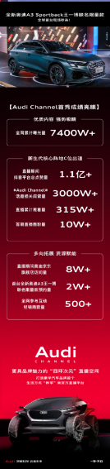


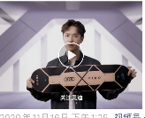
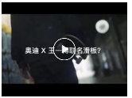



有序释放的多元化素材 Orderly release of diversified materials

Slide 18
传播概览/Comm. Overview
  II. 执行亮点/Execution Highlight
III. 媒体反馈/Media Feedback
Ⅳ. 媒体报道总结 /Media report

Slide 19




媒体观点摘选
Audi Channel，一场有灵魂的真∙直播的灵魂。满屏的弹幕，突破天际的热度，停不下来的点赞，这绝对是江湖君今年看过最“嗨”的直播。而作为豪华汽车品牌首个生活方式“种草”类的官方直播平台，Audi Channel从真正意义上打响了车企“真·直播”的第一炮。
《“亿”鸣惊人！Attitude is everything》奥迪品牌官方直播Audi Channel第一期完美收官，不仅凭实力成功圈粉，更成为品牌营销又一现象级创新案例。看了大半场，抛开“亿”鸣惊人的数字，感触有三。一、奥迪是来交朋友的；二、奥迪无处不在；三、走近年轻不如成为年轻。
刚刚首秀的Audi Channel，成为豪华汽车品牌首个生活方式“种草”类官方直播平台，围绕“人、货、场”的差异化内容，演绎奥迪品牌的“好玩、好物、好惊喜”。这种创新思维的突破，无论对站在600万台新起点的一汽-大众奥迪，还是奥迪全球，均有非同寻常的意义。
“说年轻人的话、干年轻人的事”，Audi Channel首场直播不仅带来了新颖的破圈内容，更在各细分圈层吸引到了众多天然流量。以“反套路”的直播打造豪华车首个生活平台，以“反传统”的大胆破圈探索耳目一新的营销传播，不仅准确把握住Z世代的审美喜好，更展现出年轻化品牌的锐利和朝气。“在品牌营销的道路上，奥迪将永远年轻，永远热泪盈眶。”

Slide 20
Selected media views
Audi Channel, a real live broadcast soul with soul. The full-screen barrage, the enthusiasm of breaking through the sky, and the unstoppable likes, this is definitely the most "hi" live broadcast that Jianghu Jun has watched this year. As the first official live broadcast platform of the luxury car brand's lifestyle "grass planting" category, Audi Channel has truly launched the first "True Live Broadcast" of car companies.
""100 million" blockbuster! Attitude is everything" The first issue of Audi Channel's official live broadcast of the Audi brand ended perfectly. It not only succeeded in attracting fans with strength, but also became another phenomenon-level innovation case in brand marketing. Watching most of the time, setting aside the blockbuster number of "100 million", I have three feelings. First, Audi is here to make friends; second, Audi is everywhere; third, it is better to be young than to be young.
Audi Channel, which just made its debut, has become the first official live broadcast platform of the luxury car brand's lifestyle "grass planting" category, focusing on the differentiated content of "people, goods, and fields" to interpret the Audi brand's "fun, good things, and good surprises". This breakthrough in innovative thinking is of extraordinary significance for both FAW-Volkswagen Audi, which is standing at a new starting point for 6 million units, or Audi Global.
"Speaking young people, doing young people's things", Audi Channel's first live broadcast not only brought new and broken content, but also attracted a lot of natural traffic in various segments. Create the first life platform for luxury cars with “anti-routine” live broadcasts, and explore refreshing marketing communications with “anti-traditional” bold breakthroughs, not only accurately grasping the aesthetic preferences of Generation Z, but also showing the sharpness and vigor of younger brands . "On the road of brand marketing, Audi will always be young, and tears will always be in our eyes."

Slide 21
传播概览/Comm. Overview
  II. 执行亮点/Execution Highlight
III. 媒体反馈/Media Feedback
Ⅳ. 媒体报道总结 Media report

Slide 22

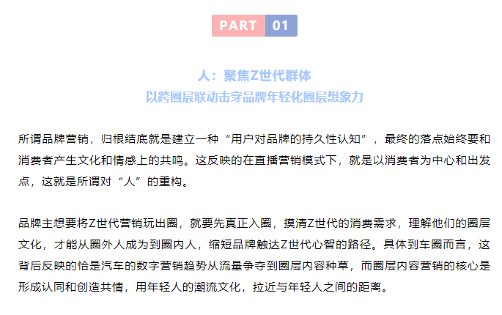
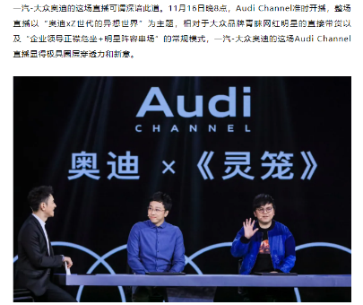
新媒体 New media
奥迪“米其林”级直播盛宴豪横破亿！看Audi Channel如何打开Z世代的异想世界
Audi "Michelin" class live broadcast feast surpassed 100 million! See how Audi Channel opens up the whimsical world of Gen Z
公关界的007 007PRSPY007
广告价值 AD Value：300000 RMB
2020-11-18

Slide 23

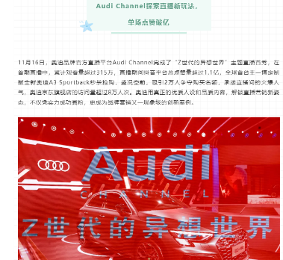
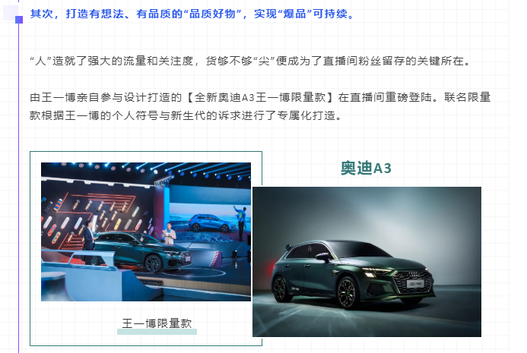
新媒体 New media
奥迪打造直播界的“米其林”盛宴，撩倒Z世代
Audi creates a "Michelin" feast in the live broadcast industry, knocking down Generation Z
4A营销门 YXM-4A
广告价值 AD Value：300000 RMB
2020-11-17

Slide 24

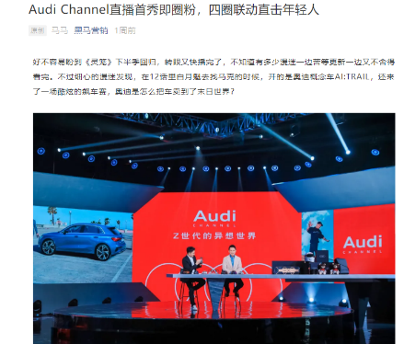
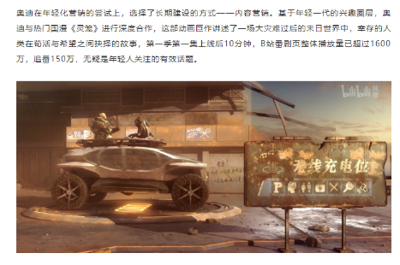
新媒体 New media
Audi Channel直播首秀即圈粉，四圈联动直击年轻人
Audi Channel's live broadcast debut is a fan, and the four-lap linkage directly hits young people
黑马营销 heimayingxiao1
广告价值 AD Value：300000 RMB
2020-11-17

Slide 25

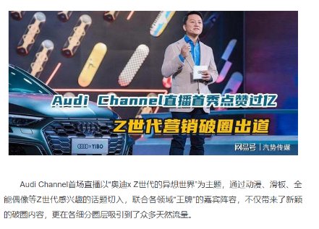
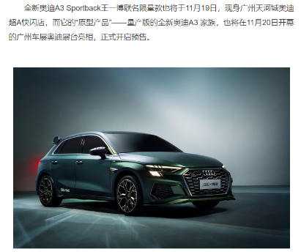
网络媒体 Web media
Audi Channel直播首秀点赞过亿 Z世代营销破圈出道
Audi Channel's live broadcast debut over 100 million likes, generation Z marketing breaks the circle debut
汽势传媒 dy.163.com
广告价值 AD Value：120000 RMB
2020-11-17

Slide 26

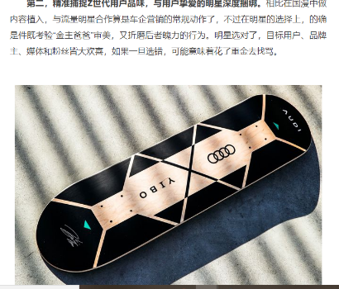
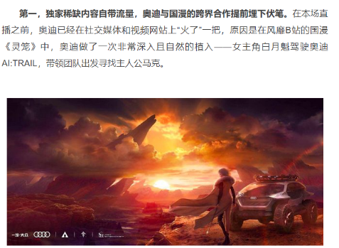
网络媒体 Web media
首场直播点赞过亿、一夜圈粉10万+，奥迪凭什么？
The first live broadcast has over 100 million likes and 100,000+ fans in one night. Why is Audi?
车壹条
广告价值 AD Value：120000 RMB
2020-11-18

Slide 27

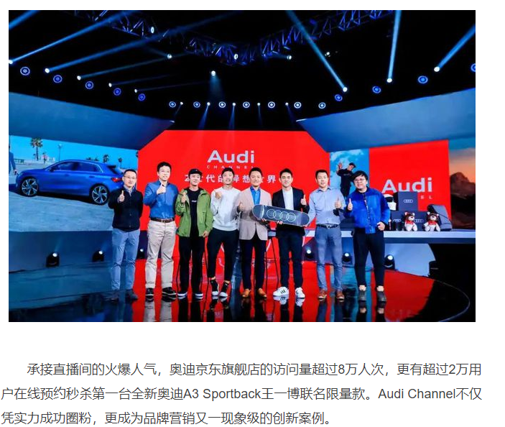
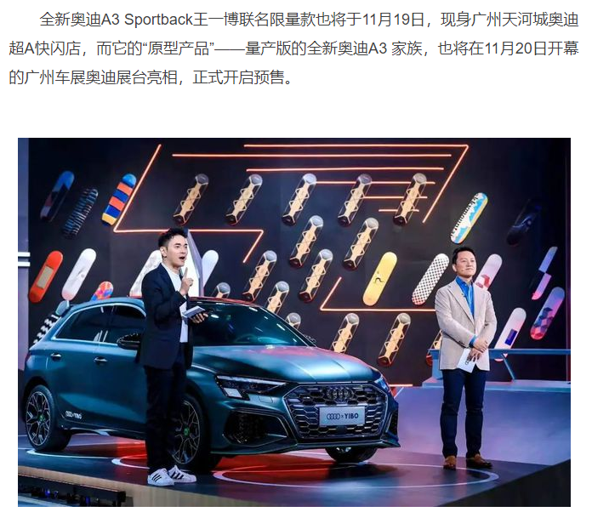
网络媒体 Web media
一汽-大众奥迪营销创新再上新高度，实力圈粉Z世代
FAW-Volkswagen Audi's marketing innovation has reached a new level, and its strength has become a fan of the Z generation
ams车评网 dy.163.com
广告价值 AD Value：120000 RMB
2020-11-19

Slide 28

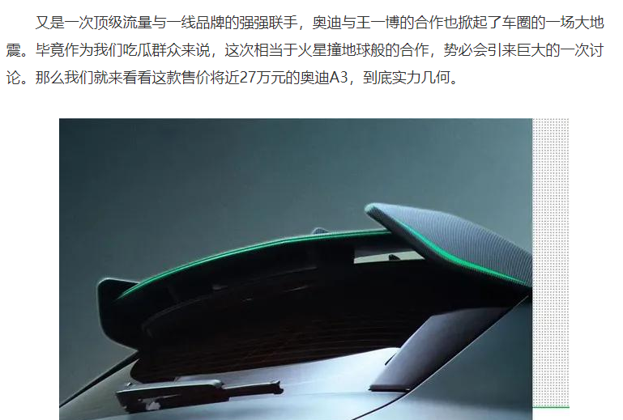
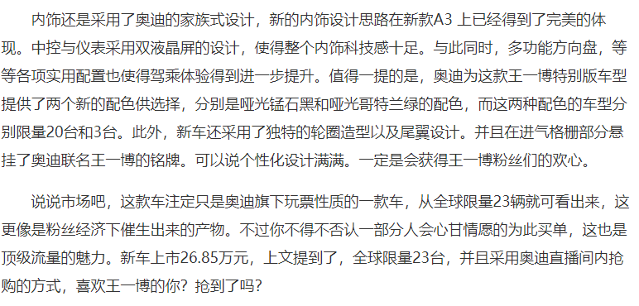
网络媒体 Web media
王一博限量版上市，奥迪这波营销，你打几分？
Wang Yibo's limited edition is on the market. How would you rate this wave of Audi marketing?
车算子 mini.eastday.com 东方网
广告价值 AD Value：120000 RMB
2020-11-20

Slide 29

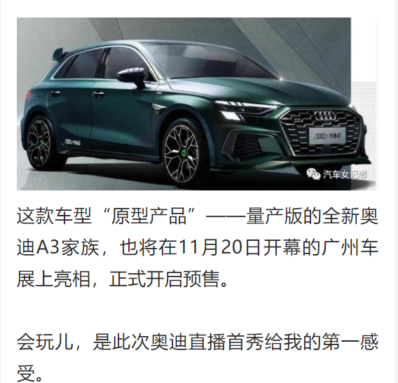
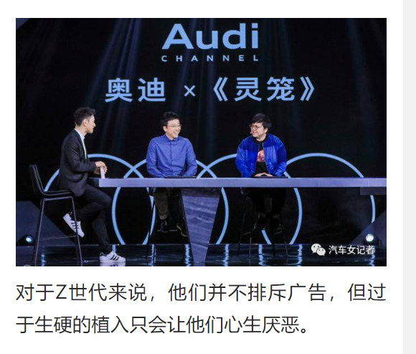
APP媒体 APP media
只种草不带货，奥迪直播首秀为何就能获得过亿点赞？
Just plant grass and not bring goods, why can Audi live broadcast its first show get more than 100 million likes?
华山论剑 1. Information 一点资讯
广告价值 AD Value：180000 RMB
2020-11-17

Slide 30

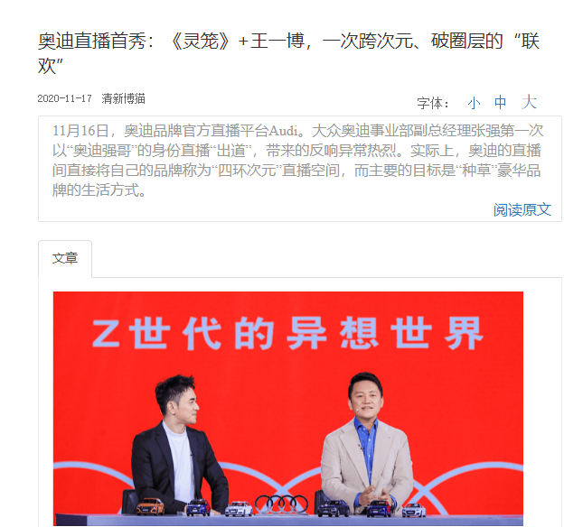
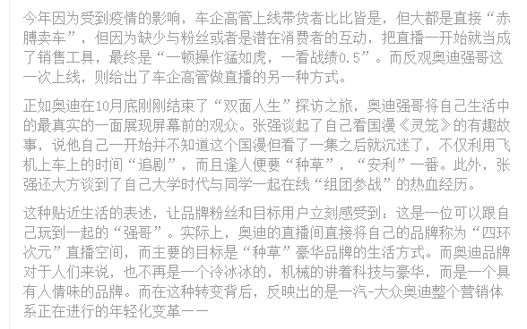
APP媒体 APP media
奥迪直播首秀：《灵笼》+王一博，一次跨次元、破圈层的“联欢”
Audi's live broadcast debut: "Spirit Cage" + Wang Yibo, a cross-dimensional, circle-breaking "party"
VIVAreaderVIVA畅读
广告价值 AD Value：180000 RMB
2020-11-17

Slide 31

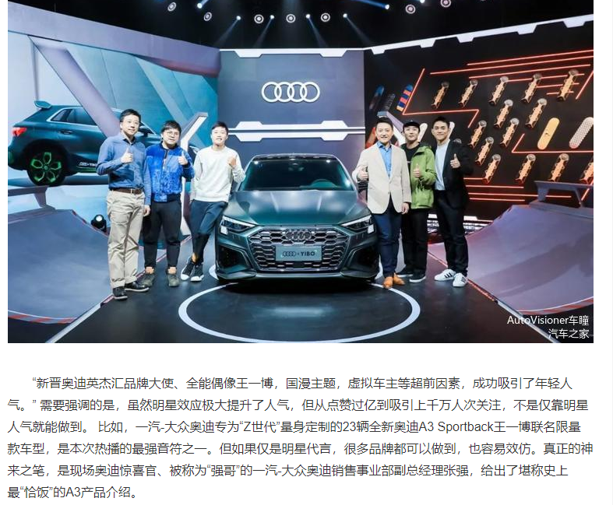
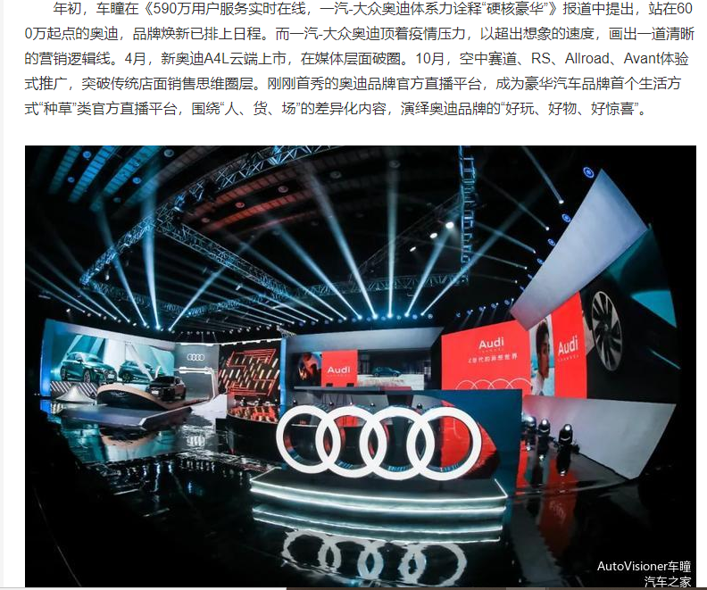
APP媒体 APP media
直播集赞吸粉破圈，奥迪突破传承的“创新进化”
Live collection of praise and fans broke the circle, Audi broke through the inheritance of "innovative evolution"
AutoVisioner 车瞳
广告价值 AD Value：180000 RMB
2020-11-19

Slide 32

谢谢！
Thank you!

